Slide 1

Multi Vendor Marketplace Script
-Buy the next Amazon or Etsy

Slide 2
What is multi vendor marketplace?
1

Slide 3
Multi Vendor marketplace is an ecommerce platform where different vendors display their products in a single platform, & share the same shopping cart.

Slide 4
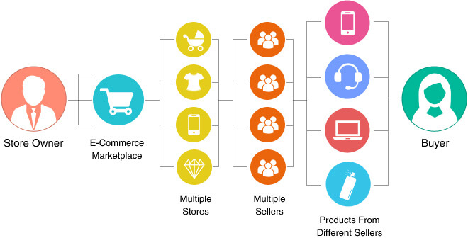
Work-flow of Multi Vendor Shopping Cart

Slide 5
What makes multi vendor shopping cart solutions outshine?
3

Slide 6
After the great success of popular online stores like Amazon and Ebay, ecommerce investors, small & medium business owners are favoring multi-vendor Shopping cart software, over regular online stores.

Slide 7
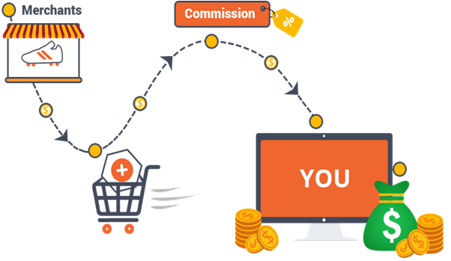
Revenue-flow of Multi vendor Shopping cart
Get A Free Consultation With Our Experts For Exploring More Revenue Models

Slide 8
Laravel Ecommerce for -
Multi Vendor Marketplace Platform

Slide 9
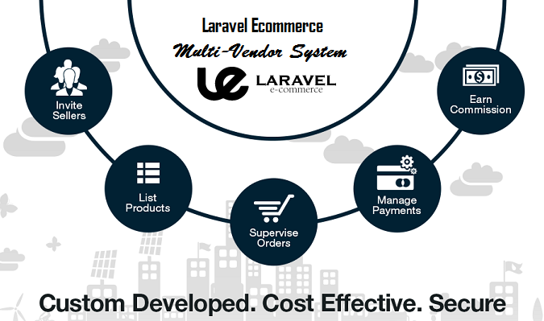
100% Source Code
Free Installation
6 Months Support
Free Add-Ons
Best in Features
Customizable Script

Slide 10
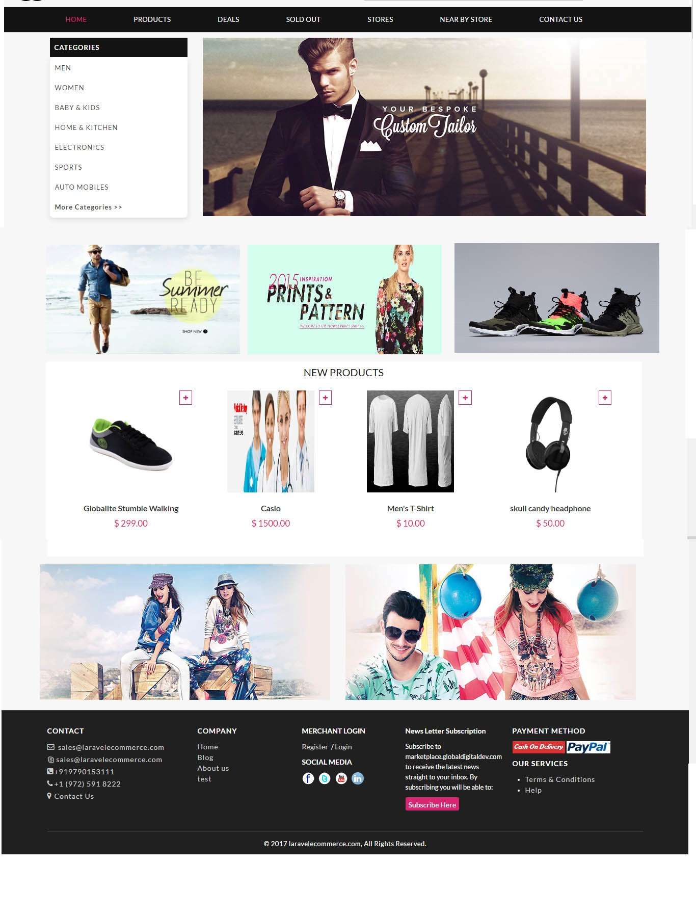
Admin Demo Front End Demo
Username: admin
Password: admin
Merchant Demo
Username: merchant@laravelecommerce.com
Password: merchant
View Demo
View Demo
View Demo

Slide 11
Laravel Ecommerce for -
Single Vendor Platform (Shopping Cart)

Slide 12
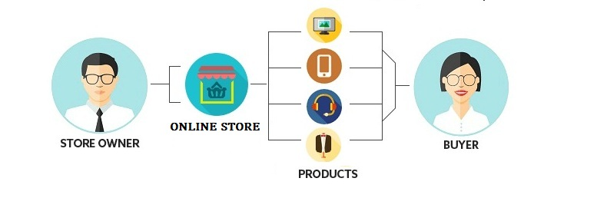

Slide 13
Are you a developer or investor or business people?
Our tailor made ecommerce solutions will help you out.
TALK TO OUR EXPERTS

Slide 14
THANKS!
Mail→ sales@pofitec.com
Skype→ laravel.ecommerce
INDIA→ +91 979 015 3222
US → +1 (972) 591 8783
Web→ www.pofitec.com

